Slide 1

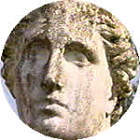
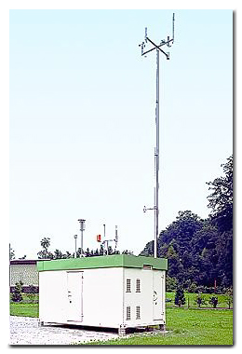
Module-3
Air Pollution Effects & Control

Slide 2
Lecture-1
Air pollution effects:
On living and nonliving beings

Slide 3
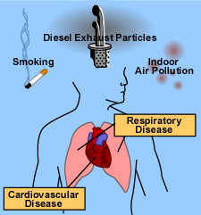
Human Health Effects
Exposure to air pollution is associated with numerous effects on human health, including pulmonary, cardiac, vascular, and neurological impairments.
The health effects vary greatly from person to person. High-risk groups such as the elderly, infants, pregnant women, and sufferers from chronic heart and lung diseases are more susceptible to air pollution.
Children are at greater risk because they are generally more active outdoors and their lungs are still developing.

Slide 4
Conti…..
Exposure to air pollution can cause both acute (short-term) and chronic (long-term) health effects.
Acute effects are usually immediate and often reversible when exposure to the pollutant ends. Some acute health effects include eye irritation, headaches, and nausea.
Chronic effects are usually not immediate and tend not to be reversible when exposure to the pollutant ends.
  Some chronic health effects include decreased lung capacity and lung cancer resulting from long-term exposure to toxic air pollutants.

Slide 5
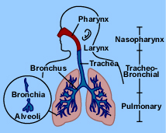
Effects on Human respiratory system
Both gaseous and particulate air pollutants can have negative effects on the lungs.
Solid particles can settle on the walls of the trachea, bronchi, and bronchioles.
Continuous breathing of polluted air can slow the normal cleansing action of the lungs and result in more particles reaching the lower portions of the lung.
Damage to the lungs from air pollution can inhibit this process and contribute to the occurrence of respiratory diseases such as bronchitis, emphysema, and cancer.

Slide 6
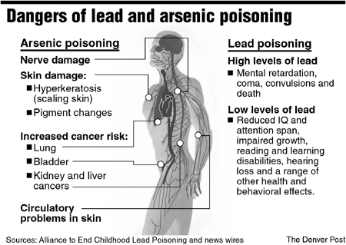

Slide 7
Table 1: Sources, Health and Welfare Effects for Criteria Pollutants.
Pollutant | Description | Sources | Health Effects | Welfare Effects
Carbon Monoxide (CO) | Colorless, odorless gas | Motor vehicle exhaust, indoor sources include kerosene or wood burning stoves. | Headaches, reduced mental alertness, heart attack, cardiovascular diseases, impaired fetal development, death. | Contribute to the formation of smog.
Sulfur Dioxide (SO₂) | Colorless gas that dissolves in water vapor to form acid, and interact with other gases and particles in the air. | Coal-fired power plants, petroleum refineries, manufacture of sulfuric acid and smelting of ores containing sulfur. | Eye irritation, wheezing, chest tightness, shortness of breath, lung damage. | Contribute to the formation of acid rain, visibility impairment, plant and water damage, aesthetic damage.
Nitrogen Dioxide (NO₂) | Reddish brown, highly reactive gas. | Motor vehicles, electric utilities, and other industrial, commercial, and residential sources that burn fuels. | Susceptibility to respiratory infections, irritation of the lung and respiratory symptoms (e.g., cough, chest pain, difficulty breathing). | Contribute to the formation of smog, acid rain, water quality deterioration, global warming, and visibility impairment.
Ozone (O₃) | Gaseous pollutant when it is formed in the troposphere. | Vehicle exhaust and certain other fumes. Formed from other air pollutants in the presence of sunlight. | Eye and throat irritation, coughing, respiratory tract problems, asthma, lung damage. | Plant and ecosystem damage.
Lead (Pb) | Metallic element | Metal refineries, lead smelters, battery manufacturers, iron and steel producers. | Anemia, high blood pressure, brain and kidney damage, neurological disorders, cancer, lowered IQ. | Affects animals and plants, affects aquatic ecosystems.
Particulate Matter (PM) | Very small particles of soot, dust, or other matter, including tiny droplets of liquids. | Diesel engines, power plants, industries, windblown dust, wood stoves. | Eye irritation, asthma, bronchitis, lung damage, cancer, heavy metal poisoning, cardiovascular effects. | Visibility impairment, atmospheric deposition, aesthetic damage.

Slide 8
Table-2: Sources, Effects of Air Pollutants on Vegetables
Pollutants | Sources | Effects on Vegetables
Aldehydes | Photochemical reactions | The upper portions of Alfalfa etc. will be affected to Narcosis if 250 ppm of aldehydes is present for 2 hrs duration.
Ozone (O₃) | Photochemical reaction of hydrocarbon and nitrogen oxides from fuel combustion, refuse burning, and evaporation from petroleum products. | All ages of tobacco leaves, beans, grapes, pine, pumpkins and potato are affected. Fleck, stipple, bleaching, bleached spotting, pigmentation, growth suppression, and early abscission are the effects.
Peroxy Acetyl Nitrate (PAN) | The sources of PAN are the same as ozone | Young spongy cells of plants are affected if 0.01 ppm of PAN is present in the ambient air for more than 6 hrs.
Nitrogen dioxide (NO2) | High temperature combustion of coal, oil, gas, and gasoline in power plants and internal combustion engines. | Irregular, white or brown collapsed lesion on intercostals tissue and near leaf margin. Suppressed growth is observed in many plants.
Ammonia & Sulfur dioxide | Thermal power plants, oil and petroleum refineries. | Bleached spots, bleached areas between veins, bleached margins, chlorosis, growth suppression, early abscission, and reduction in yield and tissue collapse occur.
Chlorine (Cl2) | Leaks in chlorine storage tanks, hydrochloric acid mists. | If 0.10 ppm is present for at least 2 hrs, the epidermis and mesophyll of plants will be affected.
Hydrogen fluoride, Silicon tetrafluoride | Phosphate rock processing, aluminum industry, and ceramic works and fiberglass manufacturing. | Epidermis and mesophyll of grapes, large seed fruits, pines and fluorosis in animals occur if 0.001 ppm of HF is present for 5 weeks.
Pesticides & Herbicides | Agricultural operations | Defoliation, dwarfing, curling, twisting, growth reduction and killing of plants may occur.
Particulates | Cement industries, thermal power plants, blasting, crushing and processing industries. | Affects quality of plants, reduces vigor & hardness and interferences with photosynthesis due to plugging leaf stomata and blocking of light.
Mercury (Hg) | Processing of mercury containing ores, burning of coal and oil. | Greenhouse crops, and floral parts of all vegetations are affected; abscission and growth reduction occur in most of the plants.

Slide 9

PEOPLE
PERSONAL
EXPOSURE
AMBIENT LEVELS
SMOKERS
NON SMOKERS
INDOOR ENVIRONMENTS
OUTDOOR ENVIRONMENTS
CHILDREN
COMMUTER
CONTROL
HOMES
OTHER
LOCATIONS
SCHOOLS
CITY
PERSONAL
PUBLIC
WALK OR
BACKGROUND
CAR
TRANSPORT
CYCLING
OFFICES
AND
SHOPS
HOT SPOTS
BUS
BARS
TRAM
METRO
Support from citizens
Support from local authorities

Slide 10
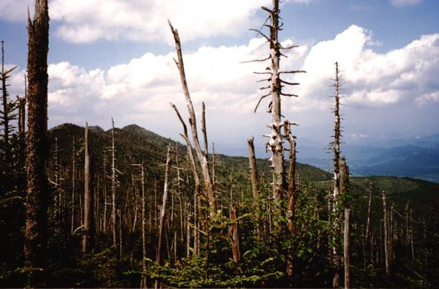

Slide 11
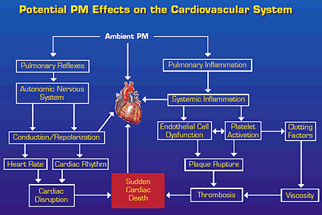

Slide 13
Lecture-2
Air pollution control:
Principles of controls, source control

Slide 14
Source Control Technology
Air quality management sets the tools to control air pollutant emissions.
Control measurements describes the equipment, processes or actions used to reduce air pollution.
The extent of pollution reduction varies among technologies and measures.
The selection of control technologies depends on environmental, engineering, economic factors and pollutant type.

Slide 15
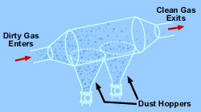
Settling Chambers
Settling chambers use the force of gravity to remove solid particles.
The gas stream enters a chamber where the velocity of the gas is reduced. Large particles drop out of the gas and are recollected in hoppers. Because settling chambers are effective in removing only larger particles, they are used in conjunction with a more efficient control device.
Figure: Settling chambers

Slide 16
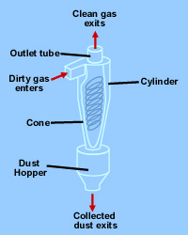
Cyclones
The general principle of inertia separation is that the particulate-laden gas is forced to change direction. As gas changes direction, the inertia of the particles causes them to continue in the original direction and be separated from the gas stream.
The walls of the cyclone narrow toward the bottom of the unit, allowing the particles to be collected in a hopper.
The cleaner air leaves the cyclone through the top of the chamber, flowing upward in a spiral vortex, formed within a downward moving spiral.
Cyclones are efficient in removing large particles but are not as efficient with smaller particles. For this reason, they are used with other particulate control devices.
Figure: Cyclone Collector

Slide 17
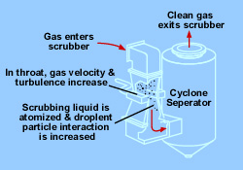
Venturi Scrubbers
Venturi scrubbers use a liquid stream to remove solid particles.
In the venturi scrubber, gas laden with particulate matter passes through a short tube with flared ends and a constricted middle.
This constriction causes the gas stream to speed up when the pressure is increased.
Figure: Venturi scrubber components

Slide 18
Conti….
The difference in velocity and pressure resulting from the constriction causes the particles and water to mix and combine.
The reduced velocity at the expanded section of the throat allows the droplets of water containing the particles to drop out of the gas stream.
Venturi scrubbers are effective in removing small particles, with removal efficiencies of up to 99 percent.
One drawback of this device, however, is the production of wastewater.

Slide 19
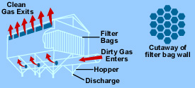
Fabric Filters
Fabric filters, or baghouses, remove dust from a gas stream by passing the stream through a porous fabric. The fabric filter is efficient at removing fine particles and can exceed efficiencies of 99 percent in most applications.
Figure: Fabric filter (baghouse) components

Slide 20
Conti…..
The selection of the fiber material and fabric construction is important to baghouse performance.
The fiber material from which the fabric is made must have adequate strength characteristics at the maximum gas temperature expected and adequate chemical compatibility with both the gas and the collected dust.
One disadvantage of the fabric filter is that high-temperature gases often have to be cooled before contacting the filter medium.

Slide 21
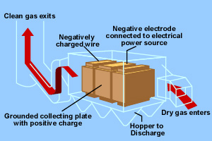
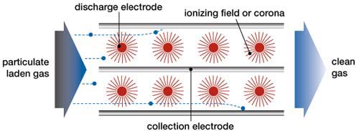
Electrostatic Precipitators (ESPs)
An ESP is a particle control device that uses electrical forces to move the particles out of the flowing gas stream and onto collector plates.
The ESP places electrical charges on the particles, causing them to be attracted to oppositely charged metal plates located in the precipitator.
Figure: Electrostatic precipitator components

Slide 22
Conti….
The particles are removed from the plates by "rapping" and collected in a hopper located below the unit.
The removal efficiencies for ESPs are highly variable; however, for very small particles alone, the removal efficiency is about 99 percent.
Electrostatic precipitators are not only used in utility applications but also other industries (for other exhaust gas particles) such as cement (dust), pulp & paper (salt cake & lime dust), petrochemicals (sulfuric acid mist), and steel (dust & fumes).

Slide 23
Control of gaseous pollutants from stationary sources
The most common method for controlling gaseous pollutants is the addition of add-on control devices to recover or destroy a pollutant.
There are four commonly used control technologies for gaseous pollutants:
  Absorption,
  Adsorption,
  Condensation, and
  Incineration (combustion)

Slide 24
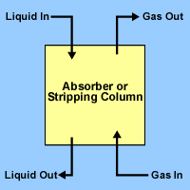
Absorption
The removal of one or more selected components from a gas mixture by absorption is probably the most important operation in the control of gaseous pollutant emissions.
Absorption is a process in which a gaseous pollutant is dissolved in a liquid.
Water is the most commonly used absorbent liquid.
As the gas stream passes through the liquid, the liquid absorbs the gas, in much the same way that sugar is absorbed in a glass of water when stirred.
Typical Packed Column Diagram

Slide 25
Conti….
Absorbers are often referred to as scrubbers, and there are various types of absorption equipment.
The principal types of gas absorption equipment include spray towers, packed columns, spray chambers, and venture scrubbers.
In general, absorbers can achieve removal efficiencies grater than 95 percent. One potential problem with absorption is the generation of waste-water, which converts an air pollution problem to a water pollution problem.

Slide 26
Adsorption
When a gas or vapor is brought into contact with a solid, part of it is taken up by the solid. The molecules that disappear from the gas either enter the inside of the solid, or remain on the outside attached to the surface. The former phenomenon is termed absorption (or dissolution) and the latter adsorption.
The most common industrial adsorbents are activated carbon, silica gel, and alumina, because they have enormous surface areas per unit weight.
Activated carbon is the universal standard for purification and removal of trace organic contaminants from liquid and vapor streams.

Slide 27
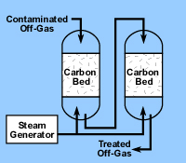
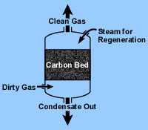
Carbon adsorption systems are either regenerative or non-regenerative.
  Regenerative system usually contains more than one carbon bed. As one bed actively removes pollutants, another bed is being regenerated for future use.
  Non-regenerative systems have thinner beds of activated carbon. In a non-regenerative adsorber, the spent carbon is disposed of when it becomes saturated with the pollutant.
Regenerative Carbon Adsorption System
Non-Regenerative Carbon Adsorption System

Slide 28
Condensation
Condensation is the process of converting a gas or vapor to liquid. Any gas can be reduced to a liquid by lowering its temperature and/or increasing its pressure.
Condensers are typically used as pretreatment devices. They can be used ahead of absorbers, absorbers, and incinerators to reduce the total gas volume to be treated by more expensive control equipment. Condensers used for pollution control are contact condensers and surface condensers.

Slide 29
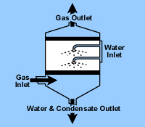
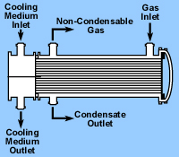
In a contact condenser, the gas comes into contact with cold liquid.
In a surface condenser, the gas contacts a cooled surface in which cooled liquid or gas is circulated, such as the outside of the tube.
Removal efficiencies of condensers typically range from 50 percent to more than 95 percent, depending on design and applications.
Contact condenser
Surface condenser

Slide 30
Incineration
Incineration, also known as combustion, is most used to control the emissions of organic compounds from process industries.
This control technique refers to the rapid oxidation of a substance through the combination of oxygen with a combustible material in the presence of heat.
When combustion is complete, the gaseous stream is converted to carbon dioxide and water vapor.
Equipment used to control waste gases by combustion can be divided in three categories:
  Direct combustion or flaring,
  Thermal incineration and
  Catalytic incineration.

Slide 31
Direct combustor
Direct combustor is a device in which air and all the combustible waste gases react at the burner. Complete combustion must occur instantaneously since there is no residence chamber.
A flare can be used to control almost any emission stream containing volatile organic compounds. Studies conducted by EPA have shown that the destruction efficiency of a flare is about 98 percent.

Slide 32
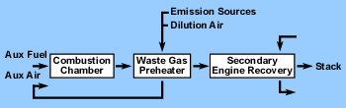
In thermal incinerators the combustible waste gases pass over or around a burner flame into a residence chamber where oxidation of the waste gases is completed.
Thermal incinerators can destroy gaseous pollutants at efficiencies of greater than 99 percent when operated correctly.
Thermal incinerator general case

Slide 33
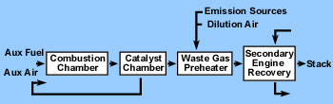
Catalytic incinerators are very similar to thermal incinerators. The main difference is that after passing through the flame area, the gases pass over a catalyst bed.
A catalyst promotes oxidation at lower temperatures, thereby reducing fuel costs. Destruction efficiencies greater than 95 percent are possible using a catalytic incinerator.
Catalytic incinerator

Slide 34
References
USEPA, 2007. Online literature from www.epa.gov
Rao, M.N. and Rao, H. V. N., 1993. Air Pollution, Tata Mc-Graw Hill, New Delhi.
Murty, B. P., 2004. Environmental Meteorology, I.K. International Pvt. Ltd., New Delhi.
Nevers, N.D. 2000. Air Pollution Control Engineering, Second Edition, Pub., McGraw Hill, New York.
Cheremisinoff, N.P., 2002. Handbook of Air Pollution Prevention and Control, Pub., Butterworth-Heinemann, Elsevier Science, USA.

